Slide 1
FIRE SAFETY
AND
PREVENTION

Slide 2
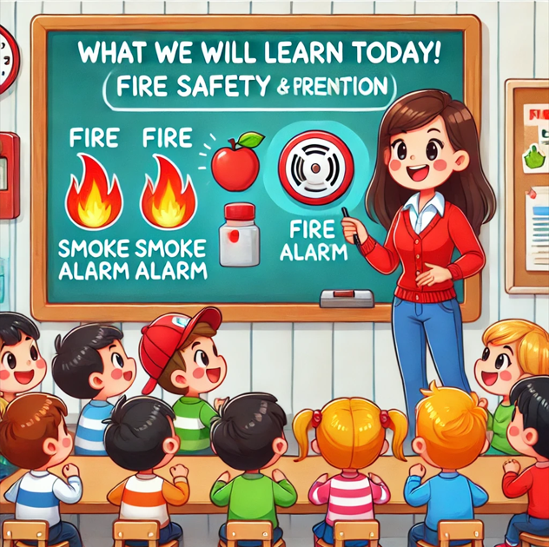
Objective
TITLE: What We Will Learn Today!
"Today, we’re going to learn how to be safe around fire and what to do if we see one.
Let’s become Fire Safety Heroes!"

Slide 3
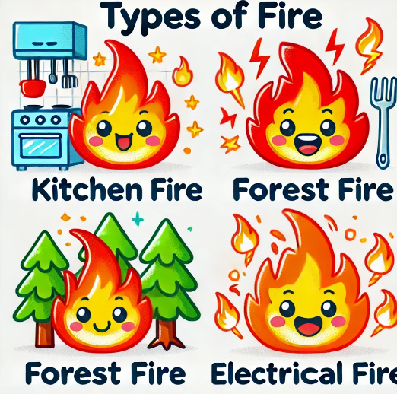
Types of Fire
TITLE: Different Kinds of Fire
"Fires can start in different ways! Some fires come from kitchens, some are outside in forests, and others can come from things that use electricity.

Slide 4
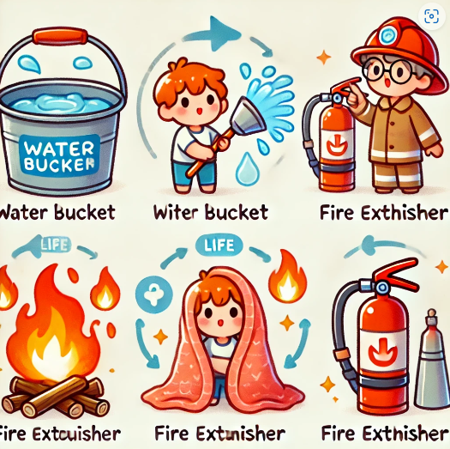
Fire Extinguishing Methods
TITLE: How We Stop Fires
"We can stop fires in different ways! We can use water, a fire extinguisher, or even a blanket for small fires."

Slide 5
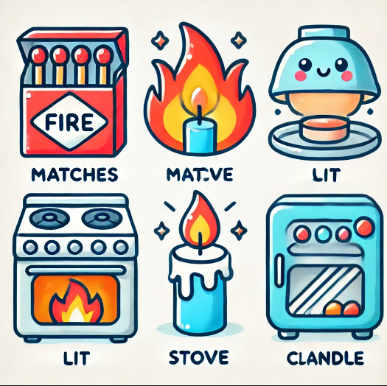
Fire Causes
TITLE: How Do Fires Start?
"Fires can start when someone plays with matches, or if a stove or candle is left alone. That’s why we need to be careful!"

Slide 6
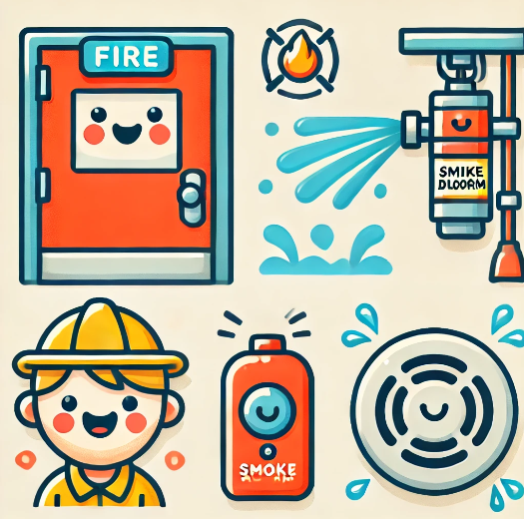
Safety Elements
TITLE: Things That Keep Us Safe!
"There are special helpers in buildings that keep us safe, like fire doors, sprinklers, and alarms!"

Slide 7
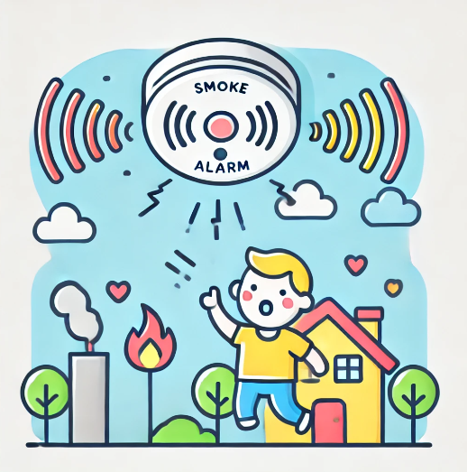
Smoke Alarms
TITLE: What is a Smoke Alarm?
"A smoke alarm makes a loud sound if there’s smoke. This sound helps us know when to get out safely!"

Slide 8

Fire Extinguisher
TITLE: Meet the Fire Extinguisher!
"A fire extinguisher is a special tool that sprays foam or water to put out a fire."

Slide 9
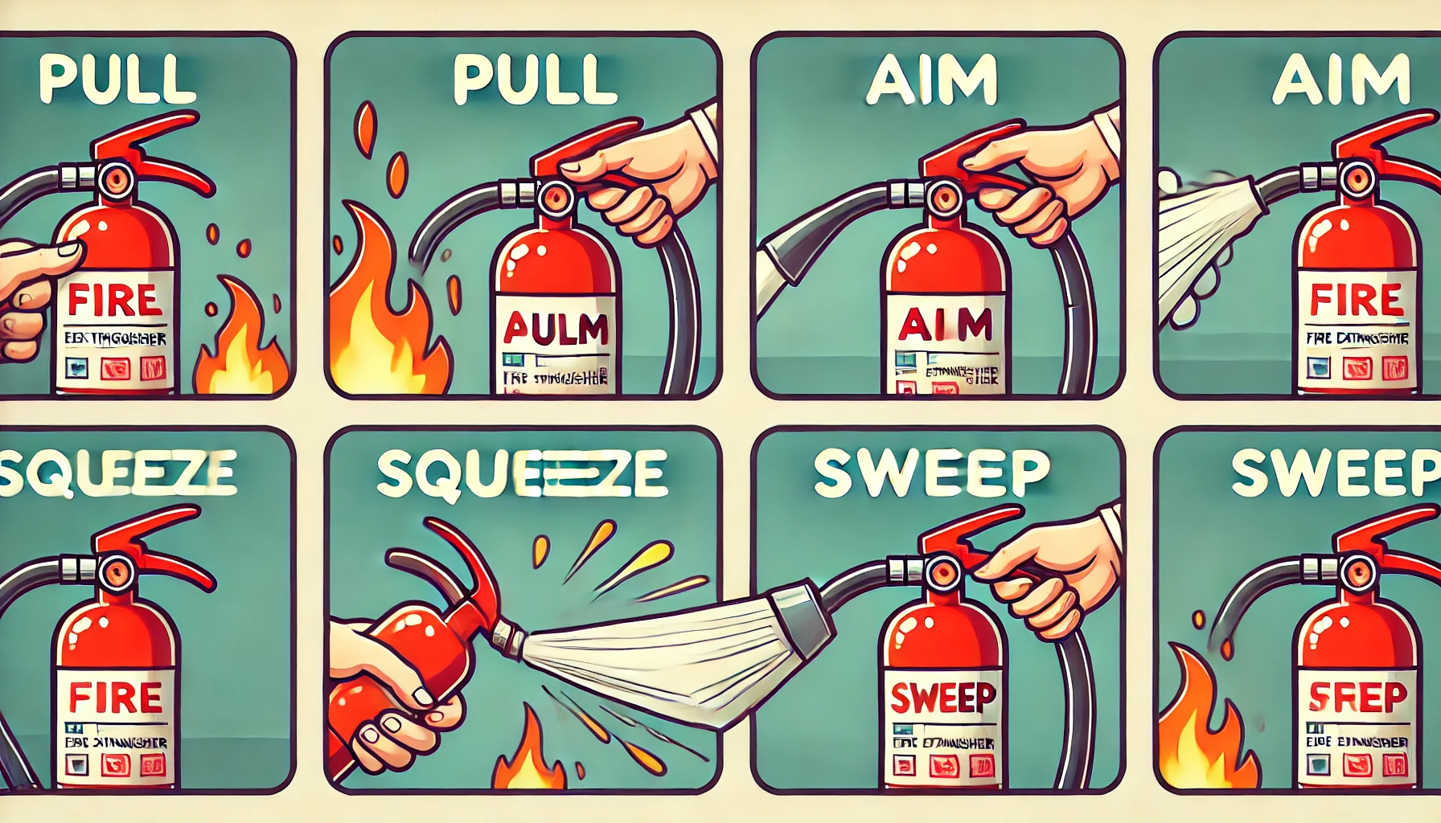
PASS Method
TITLE: How to Use a Fire Extinguisher – PASS!
P – Pull,
A – Aim,
S – Squeeze,
S – Sweep!

Slide 10
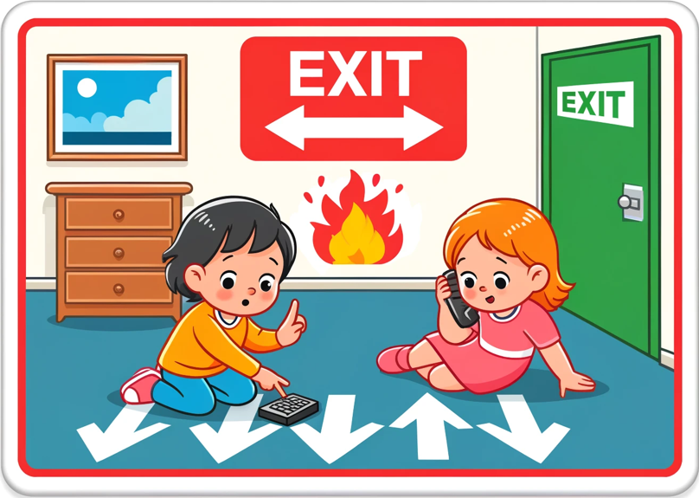
What to Do During a Fire
TITLE: What Should We Do?
"If there’s a fire, stay low to avoid smoke, follow your escape plan, and call 101!"

Slide 11
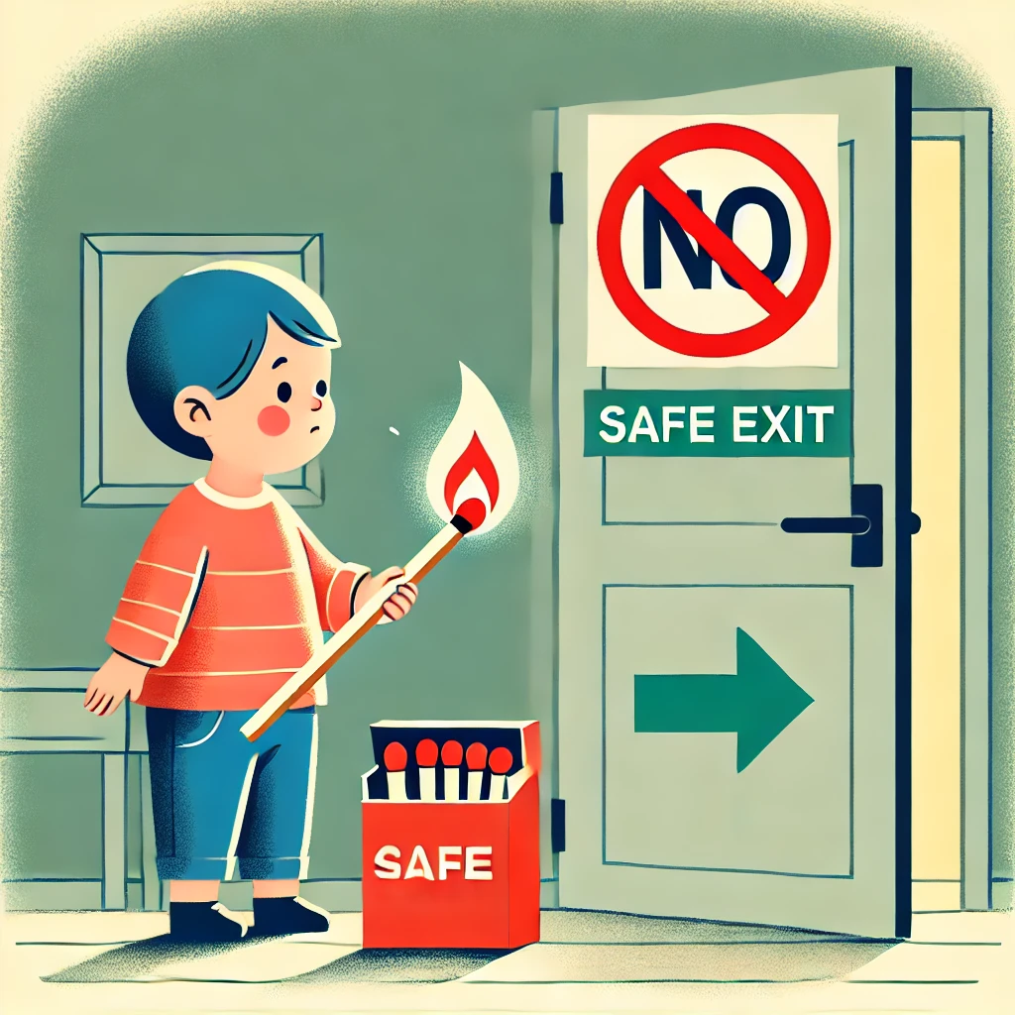
Fire Safety Tips for Kids
TITLE: Tips to Stay Safe!
"Don’t play with matches or candles. Stay away from the stove. Make sure you know your way out!"

Slide 12
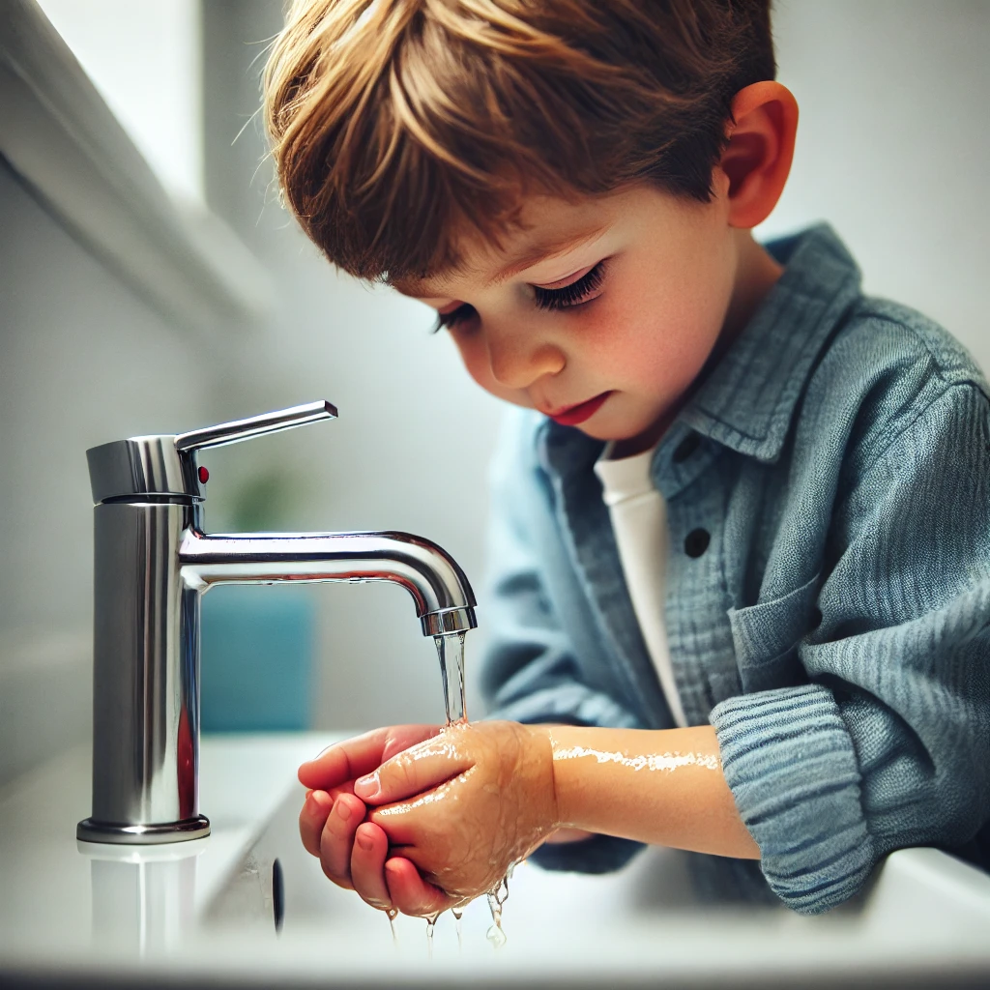
First Aid for Burn Injuries
TITLE: Ouch! What to Do for Burns
"If you get a burn, cool it with water, don’t put anything else on it, and tell an adult."

Slide 13
THANK YOU

